Slide 1
Backpressure on the Backbone
A Lightweight, Non-intrusive Traffic Engineering Approach
Christos Liaskos
Postdoctoral Researcher, FORTH, AUTH
cliaskos@ics.forth.gr

Slide 2
Acknowledgements
ERC NetVolution project (Asst. Prof. Xenofontas Dimitropoulos)
www.netvolution.eu
Studied problem:
Ossification of the inter-AS routing.
Research Committee, Aristotle Univ. of Thessaloniki
Notes:
Our list of funding sources.
This work has been primarily supported by the ERC project net-volution,
which seeks to foster innovation at the routing between ISPs.
The link is provided for further details.

Slide 3
SDN & Traffic Engineering (TE): a prosperous combo
SDN: Centrally manage and control a network.
TE: Reroute flows in real-time → provide the best possible QoS on a given infrastructure.
TE via SDN:
Highly centralized, consistent, granular TE (even per flow).
Lots of success stories:
Google’s B4,
Microsoft’s SWAN,
Bell-Labs,
….within proprietary networks!
Notes:
In this paper we seek to introduce a platform that can serve as a first step towards collaboration between distrusting ISPs.
Our tools are Traffic Engineering with SDN principles and the analytical framework of backpressure routing.
So, lets see these components separately.
First of all, TE is a highly recognized discipline in the field of network management.
And Software Defined Networking has proven to be an important asset for efficient TE.
On the one hand, SDN offers centralized network state monitoring AND, most importantly, data routing manipulation at flow-level granularity.
On the other hand, TE seeks to optimize data routing in real time, avoiding congestion, providing the best possible QoS etc.
Therefore, we can imagine why the combination of SDN and TE has been prosperous, backed-up by several success stories early on.
However, we note that SDN+TE has been successful within proprietary networks.
(And, as a side note, in the cases of companies with practically unlimited budget for research and investment to new technologies).

Slide 4
SDN/TE among (distrustful) parties?
E.g. Autonomous Systems
Too much potential, but too many obstacles:
Relinquish internal control to an external “All-powerful” SDN controller.
High degree of architectural penetration
Considerable change in internal state of affairs.
Potentially high CAPEX. Worth the risk?
SDN scalability issues.
Single/additional point(s) of failure.
Security concerns/Trust issues.
… Present solutions → Highly efficient, high complex. Too big a step in our case.
Notes:
So how about TE among self-managed elements? Like Autonomous systems, ISPs, etc.
Well, it is certain that the same gains await us, as in the case of proprietary networks.
And, Furthermore, right now TE among ASes is inexistent.
Therefore, the gain potential is enormous, especially in terms of new applications that require inter-AS QoS guarantees..
However, the obstacles are many, and not just technical.
If we examine present solutions, like Google’s B4, we will notice that they require a high degree of architectural penetration.
A network node is expected to become “soul-less”, so to speak.
All its internal routing/management processes must be delegated to some external “all-powerful, all-knowing” SDN controller.
And the considerations are many:
Do we trust this controller?
Why does it need to know so much about AS-internal stuff? Like the capabilities of my equipment.
Does it really work? “It’s a new, open technology..”, “..not really tried-out in the wild…”, “…Just within private homogenous datacenters…”
Is SDN secure? Does it add some point of failures to the network? A big question..
Even if a set of ASes agrees to central orchestration, what is the cost? Is it worth it?

Slide 5
A small-risk, high-gain step
Do not replace existing state-of-affairs within an AS.
Propose minor routing changes only.
Prioritize backwards-compatibility over all (e.g. MPLS).
Uphold SDN principles, but don’t hurry to SDN-specific tech (e.g. OpenFlow).
Utterly respect ANY peering preferences (peering rules, trust issues, etc.).
..but show immediate gains to keen participants.
Propose routing rules BUT let the AS decide. (Win-win)
Keep your hands and ears away from the AS.
Let THE AS ask us for advice when it feels like it.
Require vague, aggregate, non-private input only.
Notes:
So, instead of going all-out on a radically new way to run a network, how about going slow?
The present work proposes exactly that.
An initial, small-risk but high-gain step that can:
accentuate the benefits of central orchestration to the inter-AS world.
Convince distrustful ASes to gradually participate more to a centralized TE scheme.
The main points are the ones showing on the slide.
First, we don’t seek to replace existing state-of-affairs within an AS.
Secondly, we prioritize backwards-compatibility over all (protocols, equipment included).
Thirdly, we utterly respect ANY peering preferences.
Finally, we keep our hands and ears away from the AS.

Slide 6
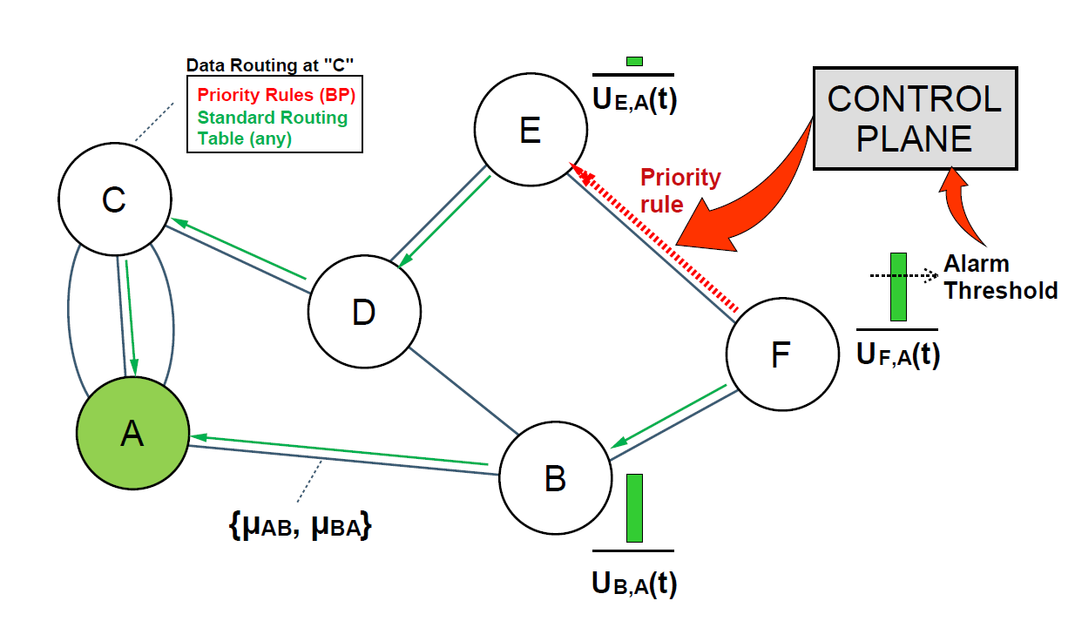
The big picture
An underlying DVR routing policy.
ASes can monitor their internal congestion levels.
The Control Plane is the “Oracle”.
An AS asks the oracle for advice On_Congestion.
The Oracle proposes problem-mitigating, priority flow rules.
Small-risk OK. High-gain?
Notes:
So here is the big picture.
We assume a network which normally operates by a DVR-based policy. (Distance Vector Routing).
The depicted nodes are autonomous systems, which can monitor their internal congestion state.
The controller acts as the “oracle”: On the event of a congestion, a node asks the oracle for advice.
The oracle replies with a set of proposed routing rules.
One of the strengths of the proposed system is that these propositions can be adopted partially and still accentuate performance benefits.
A node that accepts this proposals prioritizes the new rules over all.
Therefore, it is like having two routing policies stacked on top of each other.
The default one (DVR), and the overlayed, reactive policy.
While this is a pretty brief description, it hopefully shows that the proposed scheme has a very small degree of architectural penetration.
In this aspect it is “small-risk” for the nodes. CLINK!!
But how about the “high-gain” claim?

Slide 7
Usual TE Optimization goals
Maximize the network throughput.
Alias: Minimize the maximum link utilization.
Alias: Minimize the average link utilization.
Latency optimization.
Assign a flow/batch of flows to dedicated virtual paths with bounded latency.
Joint Throughput/Latency optimization
Alias: Assign latency-optimal paths GIVEN min-max/max-min link utilization.
Alias: Optimize throughput GIVEN p2p hops bounds.
Alias: Reduce the average network buffer level.
Notes:
To deduce the gains, lets briefly enumerated the benefits of TE in general.
A common optimization goal for TE schemes is to load balance the network’s load over all links.
And this make come in various expressions, like minimize the maximum link utilization, etc.
Another goal of existing TE schemes is the minimization of latency.
Flows or flow batches are usually assigned a QoS priority class and are served accordingly.
Alternatively, each particular flow is given a dedicated path with strictly defined e2e latency.
Finally, TE schemes may conditionally optimize throughout with regard to allowed latency bounds or vice versa.
Therefore, we state that the gain of our proposed scheme is the latency-aware throughput optimality.

Slide 8
Backpressure (BP) routing
Gains
Analytically-proven, throughput-optimal.
Delay-aware (hops-bounded paths, minimize avg buffer levels).
I.e. Joint throughput-latency optimization.
History
Originally aimed for wireless ad hoc networks.
First iteration discarded latency considerations, looping paths, path stability.
Since then: delay-aware, TCP-compatible.
Applications
Routing+scheduling in ad hoc, cellular and satellite networks.
Popular choice as firmware of network switches.
Notes:
We derive these benefits by adopting backpressure routing as the overlayed routing policy.
BPR is a well-studied and impactful algorithm, providing optimal network stability and maximal throughput.
Additionally, it is fairly straightforward to implement.
Furthermore, its optimality properties, have been proven analytically.
It has several other benefits as well, shown on the slide.

Slide 9
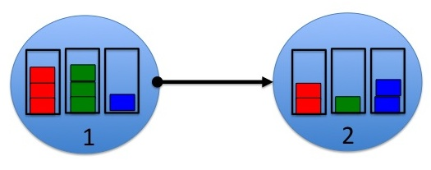
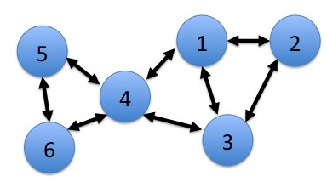
A quick tutorial on the “classic” BP routing.
We are given a net (nodes n, links μ_{nm}).
Each node n contains buffers of data
U_{n→m} destined to other nodes m.
Can also generate/consume data locally.
At time t, we are given U_{n→m}(t).
Which buffer should flow over each links?
For how long?
..In order to maximize the throughput of the net?
Notes:
As a prerequisite, let take a very brief tour on the BPR algorithm.
We assume a network comprising nodes and links.
(For our purposes the network can be assumed static, but BPR works in the dynamic case as well).
As usual, each node contains buffers of data destined to all the other nodes of the network.
Each node is also allowed to freely generate and consume data locally.
Assume that a time moment we are given the buffer levels of all nodes.
BPR answers the following question:
Which buffer should we choose to fly over each link and for how long?
Our goal is to maximize the network throughput.

Slide 10
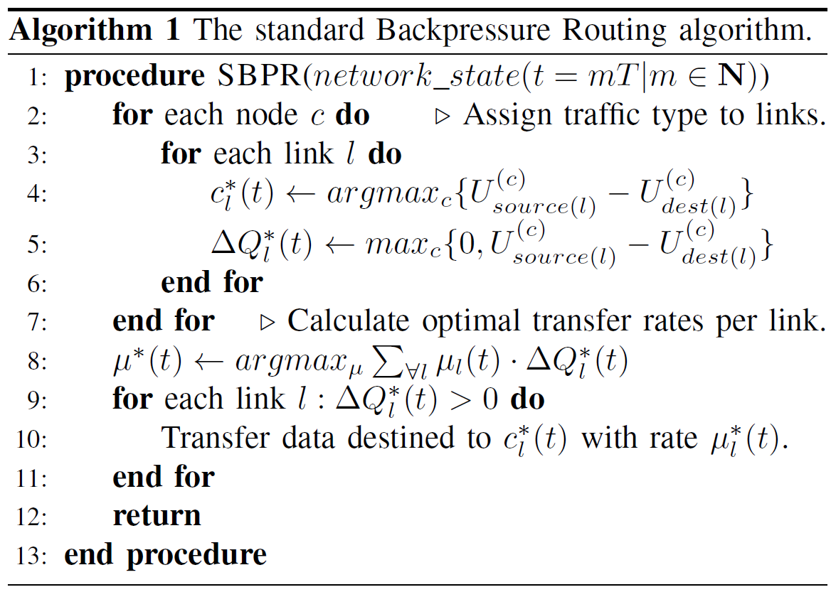
Steps
Iterate over nodes …
…and select best buffer for each link.
(We consider PRESENTLY available data only).
Set optimal transfer rate per link (if not static)…
…and transfer available data.
Notes:
I will not trouble you with the math of the original BP algorithm.
We’ll just go quickly over its steps, ignoring the math.
At first, we iterate over all nodes, and for each outgoing link we deduce the optimal buffer to fly over it.
The deduction is simply. We simply check which buffer can be offloaded the most. We call this backpressure potential.
For example in the Figure at the top we see a magnification of the link connecting nodes 1 and 2.
The best buffer to fly over the outgoing link 1->2 is obviously the green buffer, since the mutual difference is TWO, instead of ONE.
We do that for each network link.
Notice however, that the original BP algorithm considers data that is presently available at the buffers. We will need this soon.
And that’s all. Pretty simple. We proceed to transfer data according to our choices until the next application of BPR in the future.

Slide 11
Applying BP-TE on backbone networks
Conceptually straightforward. Important points:
Use BP to derive flow rules.
Don’t apply at buffer-level.
The AS Congestion metric is subjective and virtual.
Free to customize!
“Fire” when needed
(e.g. onCongestion, onASquery events).
Novel analytical result:
Classic BP is not accurate!
Must consider FUTURE traffic, not just PRESENT!
Easy to respect peering preferences.
Just filter the neighborhood search accordingly.
Delay-awareness?
US(now)
Neighbor(now)
OPTIMAL!
US(now)
Neighbor(future)
Notes:
The application of BP as a TE scheme for backbone networks should be straightforward.
The key-points are that:
- We do not apply BPR at buffer level. We use it to derive ROUTING RULES that remain active until withdrawal or idle timeout.
The “buffer-level” in our case is virtual. We just need a metric of how congested is a node w.r.t. to a destination.
A final key-point is that BPR is applied on the underlying DVR policy only when requested. No need to run when the network runs smoothly by itself.
A major contribution of the present work is what you see at the right.
The present work proved analytically that the backpressure potential should consider:
THE SENDERS CURRENT STATE, AND THE RECEIVER’S FUTURE STATE.
In other words, the controller that executed BPR must have a prediction module, to forecast the future congestion states of the nodes.
This may add complexity, and forecasting is certainly tricky, but ISPs already utilize such modules.
I’ll skip the analysis and redirect you to the paper for more.
Finally, it worth noting that its relatively easy to take into account peering preferences. (Either the controller’s, or the nodes’ own).
We just calculate the backpressure potential for all neighbors that are valid by a given policy.
Up to this point we have achieved throughput optimality. A high gain, OK, but how about latency?

Slide 12
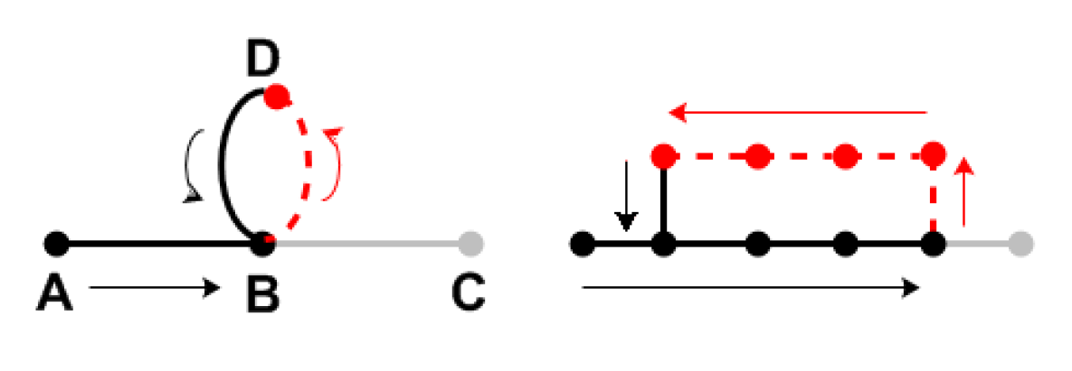
BP-DVR routing policy stitching.
If naively combined, BP and DVR may lead to routing loops.
Luckily, loop-free stitching is easy.
Operates similarly to peering policies.
I.e. neighborhood filtering.
We propose:
An analysis-driven process (BD-DV Stitch).
Optimal results, purely analytical motivation. See paper..
A more practical approach (NHOPS Stitch).
Slightly worse results, but easily conveyable motivation.
Backed-up by related work.
Both approaches imbue BP with delay-awareness.
Notes:
It turns out that latency-awareness comes naturally, when we properly bind together DVR and BP-derived flow rules.
First, lets see what an IMPROPER combination of DVR and BP policies looks like.
Lets assume 4 nodes, A,B,C and D as shown on the leftmost figure.
At some point, BP dictates B to direct traffic destined towards C to node B. This is the red dashed line.
However, D has a DVR rule that returns traffic back to B. And thus a loop is formed.
That’s a naïve combination of policies. And of course this can occur after multiple steps, as shown in the rightmost figure.
We propose two techniques for PROPERLY binding BP and DVR rules.
The first one is the best, performance-wise. However, it is derived from analysis, and I have a hard time finding a practical way of conveying the “trick” behind it.
Luckily, the second way is practical and easy to present. Plus, it offers just marginally-worse results in practice.
I will be presenting this one.
We state, however, that both techniques offer delay-awareness without compromising throughput optimality.

Slide 13
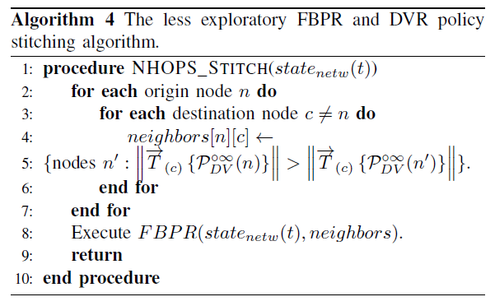
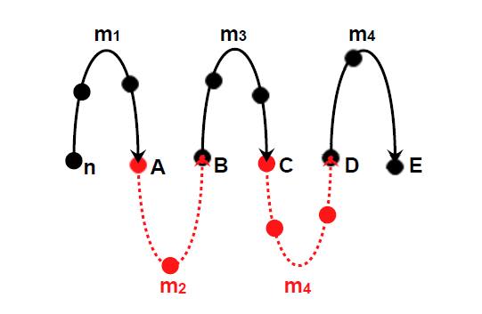
NHOPS Stitch & Delay-awareness
Ying, Lei, et al. "On combining shortest-path and back-pressure routing over multihop wireless networks." IEEE/ACM Transactions on Networking (TON)19.3 (2011): 841-854.
Key idea: keep the number of hops
non-strictly decreasing with each BP
derived flow rule.
How to: By applying nhops-based filtering at the neighbor selection steps 3-6. Then, perform FBPR as presented.
Since nhops drops over a path, no loops can be formed!
Hops to E
Notes:
The technique I will present is named “NHOPS stitching” and is closely related to keeping to the number of hops towards a target bounded.
This also introduces latency-awareness. In other words, throughput is optimal under the condition that latency is bounded.
So here is how NHOPS stitch works.
We are given a DVR path from a node N toward node E, as shown in the Figure.
At some point, BPR proposes a redirection over node A.
We simply make sure that this redirection does not lead to nodes with greater or equal hop count to the target E.
Our entry point is once again the neighborhood step step of the algorithm.
In this manner, we have made sure that the number of hops remains strictly decreasing over the stitched paths.
Therefore, loops can no longer be formed.
This technique has been successfully used in wireless ad hoc applications of BPR as well by Ying et al.

Slide 14
SIMULATIONS
A 5x5 grid topology, to ensure rich path diversity.
Not necessary for operation, but important for demonstrating potential.
OSPF as the underlying routing policy.
Latency-optimal bound. (Under minimal load).
Periodic application of FBPR over OSPF. (Every T sec).
To quantify dependence from controller interaction frequency.
Per experiment:
Varying alarm threshold and period T. (Important for controller dependence).
Varying data generation rate per each node.
(Affects impact of forecasting AND the volatility of the network’s state).
Measure:
Throughput, latency, data overflow rates.
Notes:
We now proceed to present the simulations of the proposed system.
First, we assume a topology with rich path diversity.
The idea is that we want to see the potential of the proposed TE, without being affect by topological attributes.
Secondly, we use OSPF as the underlying, default routing policy.
The reason is that OSPF is strictly latency-aware, and provides a good metric of performance from that aspect, especially under minimal network load.
Thirdly, while the proposed scheme is event-based, we resort to a periodic callback scheme.
The reason is that we would like to study and quantify the imposed dependence from the controller.
How infrequent can the interaction with the oracle be, while maintaining good performance over all?
Therefore, we introduce the actuation period T.
The alarm threshold has the meaning that at each actuation step, we seek to offload nodes with traffic greater than this threshold.
Finally, we vary the rate at which new traffic is generated within the network. Therefore, we study the stability of the network as well.
We measure standard performance parameters, that is throughput, latency and data overflow rate.

Slide 15
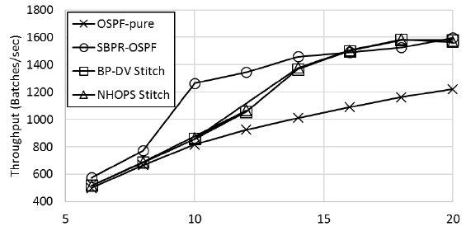
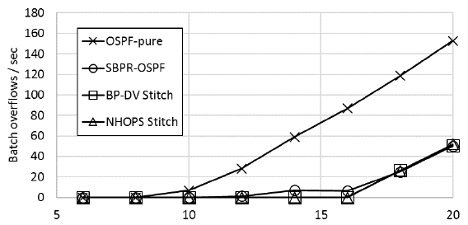
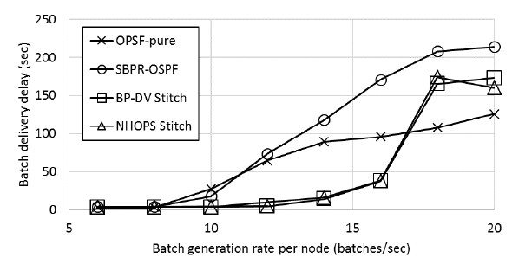
Results 1/3
Maximum controller dependence case:
Alarm at 1% (i.e. Always ON).
T=1sec.
Proposed schemes (NHOPS, BP-DV):
Better latency than OSPF for minimal→medium load.
Same throughput as Classic BP (SBPR) for maximal network load.
Considerably increased network stability.
Notes:
In the first experiment, we seek to examine the best possible performance that the system can yield.
We therefore assume vary frequent interaction with the controller.
We achieve this by setting the alarm level and the actuation period at the lowest possible settings.
The x-axis represents the traffic generation rate within the network.
Studying the plots from bottom to top,
We notice that the proposed schemes (Denoted with TRIANGLES and SQUARES) offer better latency than pure OSPF, even for low loads!
OSPF wins only for very high loads. However, if we study the corresponding performance in terms of overflows, we will notice that this is achieved
By dropping most of the traffic away due to buffer overflows.
On the contrary, the proposed schemes keep the overflow rate minimal, increasing the stability of the network considerably.
This is also evident from the throughput performance at the top plot.
The throughput of the combined OSPF and BPR is strictly higher than pure OSPF, in all examined cases.
The classic BPR is the one with the maximum throughput. However, this increase includes looping traffic and excessively large paths, as is evident from the latency performance.
Therefore, the increased throughput of the classic BPR is not really helpful.

Slide 16
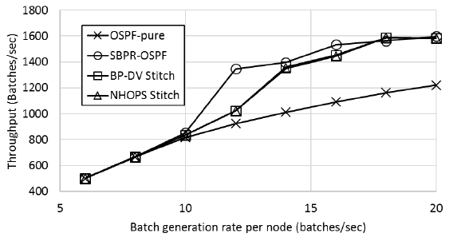
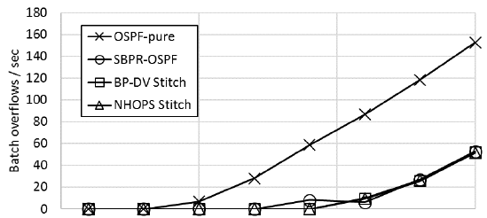
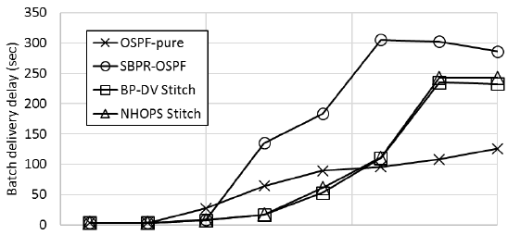
Results 2/3
Gradually “detaching” from the controller:
Alarm at 20% of capacity.
T=5sec.
Proposed schemes (NHOPS, BP-DV):
Latency is worse than pure OSPF, but data overflow is practically at 0%.
For OSPF, the data overflow rate is ~25%.
Same throughput as Classic BPR.
Considerably increased network stability.
Notes:
When we gradually limit the dependence from the controller, the relative ranking of the algorithms is retained.
The detachment is obtained by increasing the actuation period and the alarm threshold of the nodes.
The respective throughputs and overflows remain the same.
However, the latency of the proposed schemes increases slightly.
On the other hand, the latency of the classic BPR increases sharply.
This simply means that the classicBPR-derived rules remain active for longer than need. This is expected, since the interaction with the controller is less frequent.
Notice that, we have disallowed flow rule withdrawal due to idling. The controller is solely responsible for withdrawing and proposing new rules.
However, the forecasting abilities of the proposed scheme make the rules it proposes valid for extended periods of time, keeping the impact on latency low.
This is not the case for the classic BPR, whose latency performance deteriorates quickly.

Slide 17
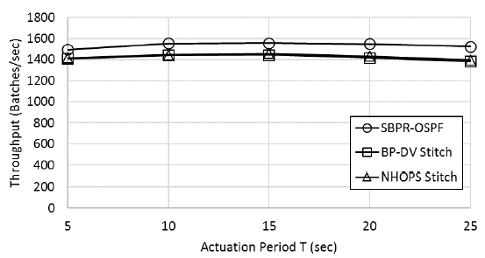
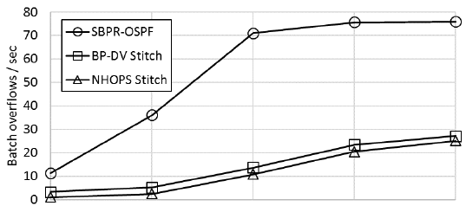
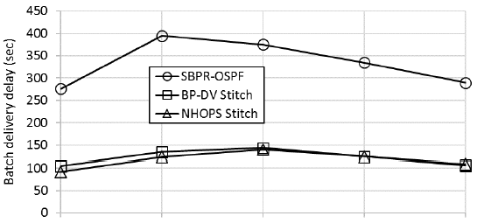
Results 3/3
Further “detachment” from the controller:
Alarm at 20% of capacity.
T: 25sec.
Constant data generation rate per node (medium network load)
Proposed schemes (NHOPS, BP-DV):
The performance in terms of latency and throughput depends little on the controller interaction frequency.
Classic BP
behaves poorly latency-wise and overflow-wise, as expected.
Notes:
We proceed to detach from the controller even further.
We gradually increase the actuation period to 25sec. (This is the new x-axis).
We notice that the performance of the proposed algorithms remains the same!
This is sustained regardless of the infrequent interaction with the controller.
And once again, this is not the case for the classic BPR algorithm, which has no forecasting mechanism, and therefore, is not able to yield long-lived flow rules.

Slide 18
Conclusion
Backpressure routing (BPR) benefits to the SDN-powered TE.
Network throughput maximization
Stability under increased network load.
Little dependence from-and load for-the SDN controller.
Robust co-existence with Delay-aware policies, while respecting peering rules.
Pave the way for new, lightweight TE schemes that:
Require minimal commitment,
Can be deployed with minimal cost.
Encourage gradually increasing cooperation among autonomous, distrustful network entities.
Notes:
I’ll summarize the presentation.
We presented a new TE scheme that abides by the basic SDN principles of central network management.
But we targeted a lightweight, non-intrusive approach.
Our key-enabler was the application of BPR in order to derive temporal, congestion-soothing flow rules.
And in doing that, we brought the benefits of BPR in the TE world as well. These are:
- Throughput maximization. (Which other TE solutions achieve without analytic proof and with extensive architectural changes).
Increased stability.
Latency-awareness,
and a very versatile way of respecting peering agreements.
The presented scheme aspires to be a small-risk high-gain step for convincing distrustful ASes to give collaboration a try.

Slide 19
Future Work
Implementing a prediction module and the complete system in a realistic testbed.
Endowing the BPR/SDN controller with memory and simple learning capabilities.
A smart, constantly evolving routing system.
E.g. application of learning automata or taboo search algorithms over past BPR-derived routing decisions.
Finally, taking into account the traffic monitoring abilities of OpenFlow:
BPR combined with an automatic subnetting system.
Goals:
maximize the backpressure backlog AND
optimize the specificity of the introduced flow rules.
Notes:
Our future work.
We would like very much to implement our scheme in a realistic testbed and pinpoint any omissions.
We would also like to make BPR the first, autonomous, self-improving TE scheme.
And we feel we can start doing that by using learning automata or taboo search algorithms over past BPR-derived routing decisions.
Finally, we didn’t cover subnetting. In reality, TE schemes seek to contain their changes to the IP prefixes that need them the most.
We would like to incorporate such a mechanism to our scheme as well.

Slide 20
Questions?

